Slide 1


Lecture 3
DLI
Conditional Probability and Independence
条件概率和独立性

Slide 2
DLI
Outline
Conditional Probability 条件概率
Bayes‘s Formula 贝叶斯公式
Independence 独立性

Slide 3
DLI
Introduction
In this chapter, we introduce one of the most important concepts in probability theory, that of conditional probability.
The importance of this concept is twofold.
In the first place, we are often interested in calculating probabilities when some partial information concerning the result of an experiment is available; in such a situation, the desired probabilities are conditional.
Second, even when no partial information is available, conditional probabilities can often be used to compute the desired probabilities more easily.

Slide 4
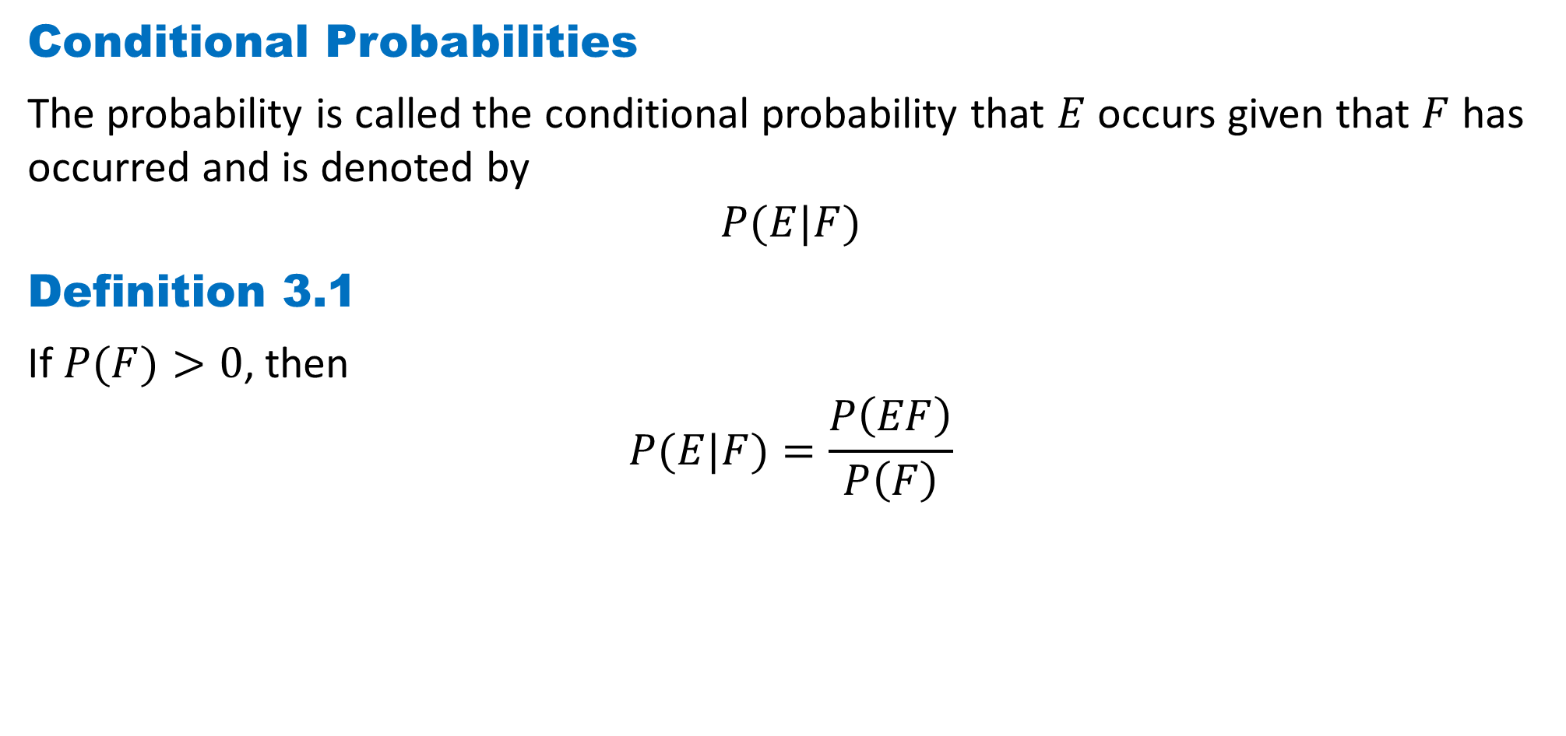
DLI
Conditional Probabilities
The probability is called the conditional probability that $E$ occurs given that $F$ has occurred and is denoted by
$$P(E|F)$$
Definition 3.1
If $P(F)>0$, then
$$P(E|F)=\frac{P\left(EF\right)}{P\left(F\right)}$$

Slide 5
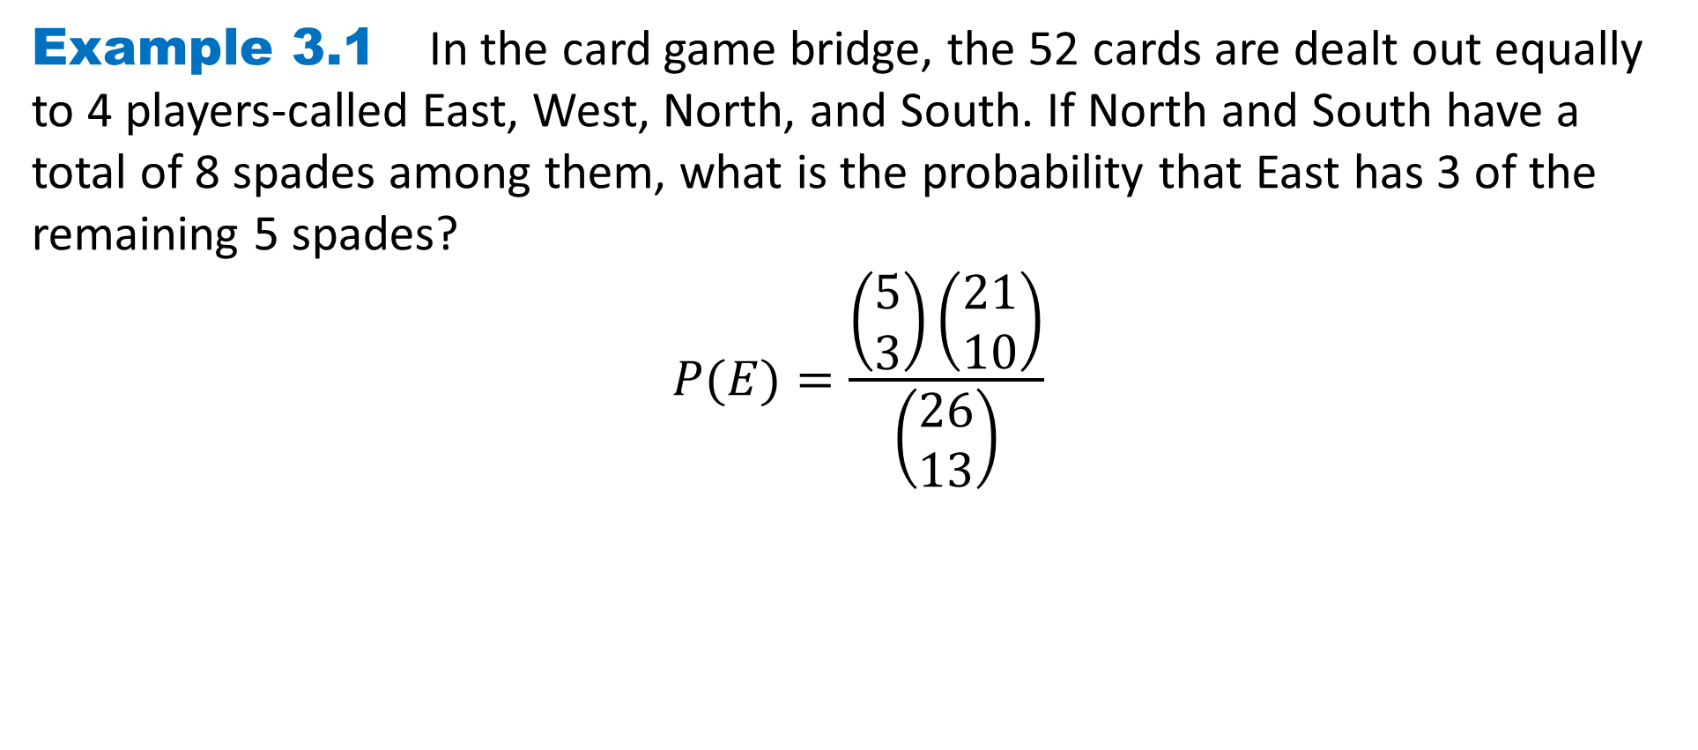
DLI
Example 3.1 In the card game bridge, the 52 cards are dealt out equally to 4 players-called East, West, North, and South. If North and South have a total of 8 spades among them, what is the probability that East has 3 of the remaining 5 spades?
$$P(E)=\frac{\left(\begin{matrix}5 \\ 3\end{matrix}\right)\left(\begin{matrix}21 \\ 10\end{matrix}\right)}{\left(\begin{matrix}26 \\ 13\end{matrix}\right)}$$

Slide 6
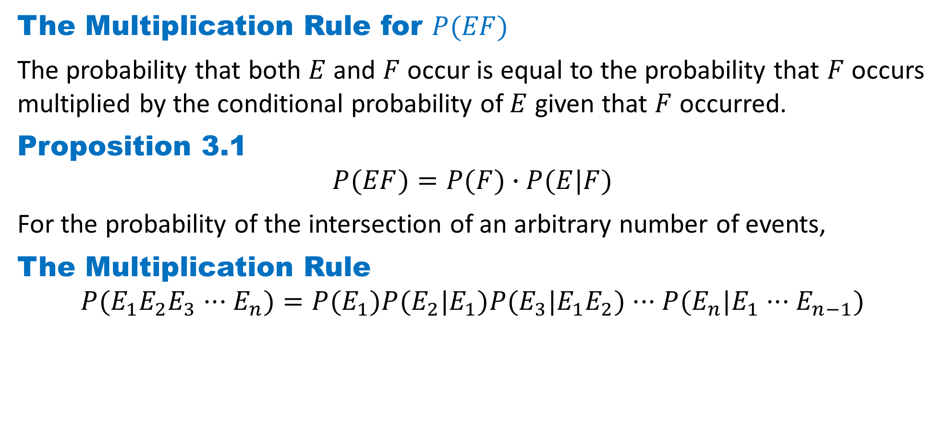
DLI
The Multiplication Rule for $P(EF)$
The probability that both $E$ and $F$ occur is equal to the probability that $F$ occurs multiplied by the conditional probability of $E$ given that $F$ occurred.
Proposition 3.1
$$P(EF)=P(F)∙P(E|F)$$
For the probability of the intersection of an arbitrary number of events,
The Multiplication Rule
$$P(E_{1}E_{2}E_{3}···E_{n})=P(E_{1})P(E_{2}|E_{1})P(E_{3}|E_{1}E_{2})···P(E_{n}|E_{1}···E_{n−1})$$

Slide 7
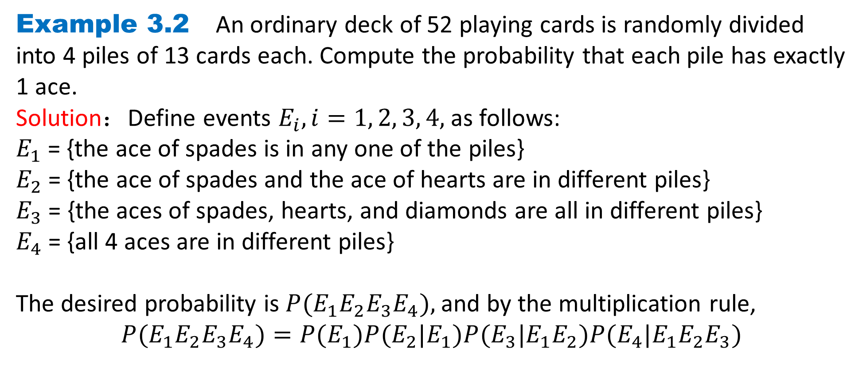
DLI
Example 3.2 An ordinary deck of 52 playing cards is randomly divided into 4 piles of 13 cards each. Compute the probability that each pile has exactly 1 ace.
Solution：Define events $E_{i}, i=1, 2, 3, 4,$ as follows:
$E_{1}$= {the ace of spades is in any one of the piles}
$E_{2}$= {the ace of spades and the ace of hearts are in different piles}
$E_{3}$ = {the aces of spades, hearts, and diamonds are all in different piles}
$E_{4}$= {all 4 aces are in different piles}
The desired probability is $P(E_{1}E_{2}E_{3}E_{4}),$and by the multiplication rule,
$$P(E_{1}E_{2}E_{3}E_{4})=P(E_{1})P(E_{2}|E_{1})P(E_{3}|E_{1}E_{2})P(E_{4}|E_{1}E_{2}E_{3})$$

Slide 8
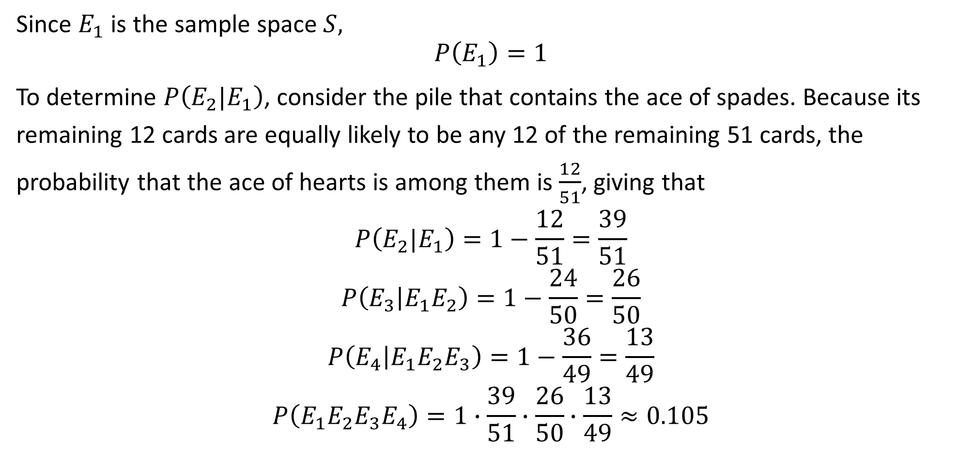
DLI
Since $E_{1}$ is the sample space $S,$
$$P\left(E_{1}\right)=1$$
To determine $P\left(E_{2}|E_{1}\right)$, consider the pile that contains the ace of spades. Because its remaining 12 cards are equally likely to be any 12 of the remaining 51 cards, the probability that the ace of hearts is among them is $\frac{12}{51}$, giving that
$$P\left(E_{2}|E_{1}\right)=1−\frac{12}{51}=\frac{39}{51}$$
$$P\left(E_{3} | E_{1}E_{2}\right)=1−\frac{24}{50}=\frac{26}{50}$$
$$P\left(E_{4} | E_{1}E_{2}E_{3}\right)=1−\frac{36}{49}=\frac{13}{49}$$
$$P\left(E_{1}E_{2}E_{3}E_{4}\right)=1∙\frac{39}{51}∙\frac{26}{50}∙\frac{13}{49}≈0.105$$

Slide 9
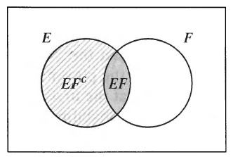
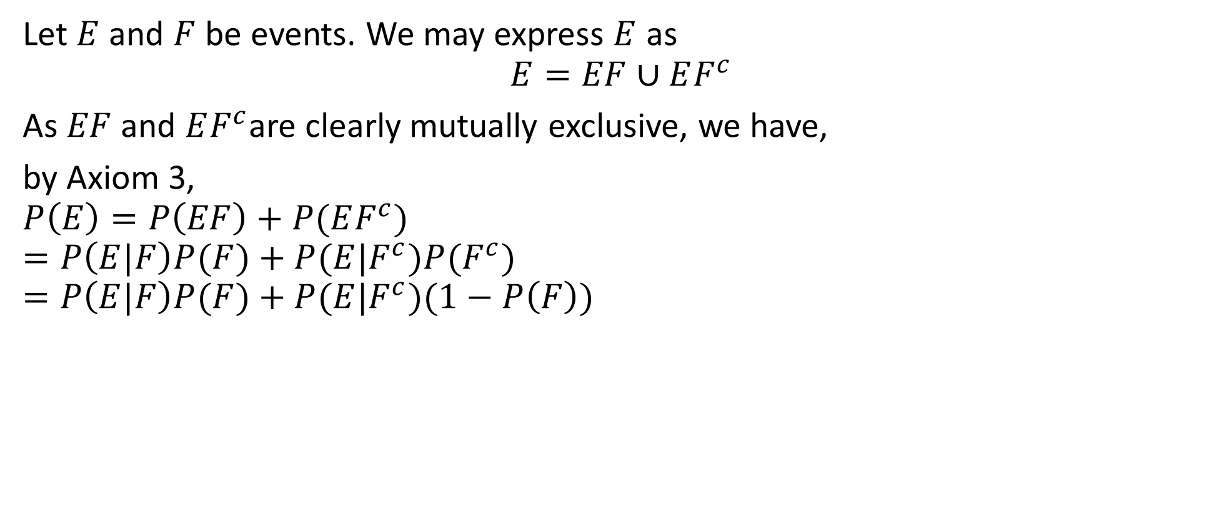
DLI
Let $E$ and $F$ be events. We may express $E$ as
$$E=EF∪EF^{c}$$
As $EF$ and $EF^{c}$are clearly mutually exclusive, we have,
by Axiom 3,
$$P\left(E\right)=P\left(EF\right)+P(EF^{c})$$
$$=P\left(E|F\right)P(F)+P(E|F^{c})P(F^{c})$$
$$=P\left(E|F\right)P(F)+P(E|F^{c})(1−P\left(F\right))$$

Slide 10
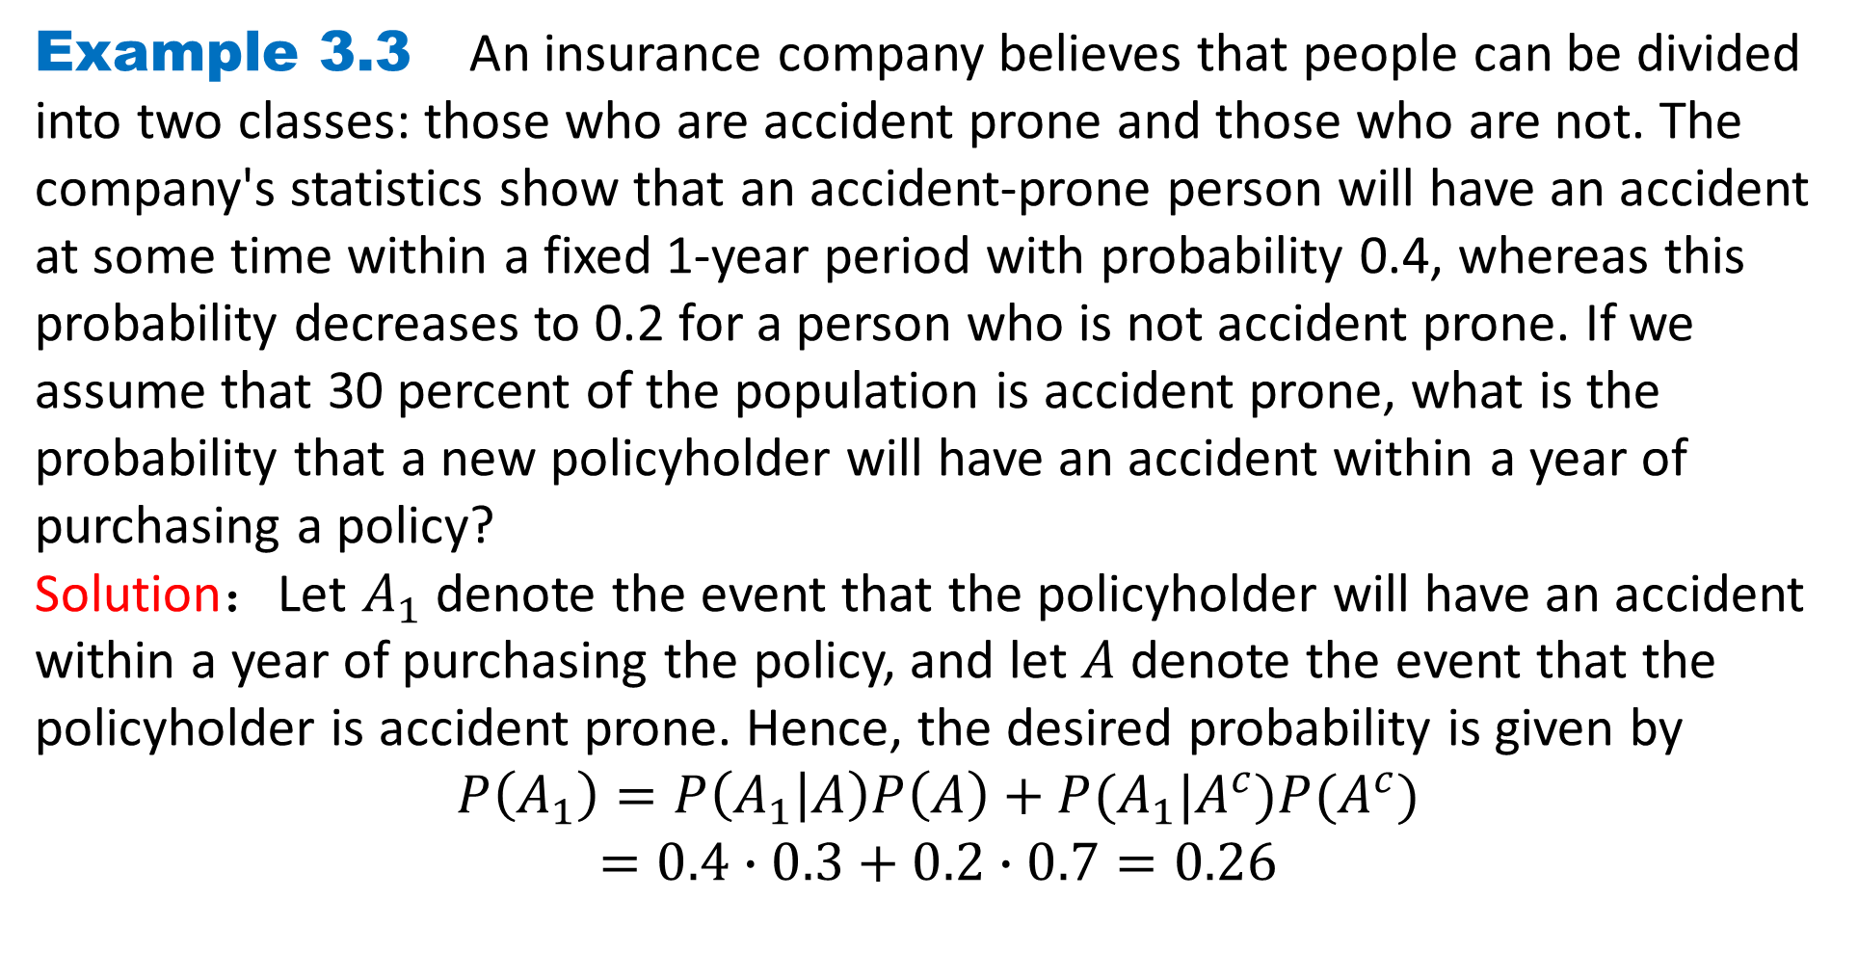
DLI
Example 3.3 An insurance company believes that people can be divided into two classes: those who are accident prone and those who are not. The company's statistics show that an accident-prone person will have an accident at some time within a fixed 1-year period with probability 0.4, whereas this probability decreases to 0.2 for a person who is not accident prone. If we assume that 30 percent of the population is accident prone, what is the probability that a new policyholder will have an accident within a year of purchasing a policy?
Solution：Let $A_{1}$ denote the event that the policyholder will have an accident within a year of purchasing the policy, and let $A$ denote the event that the policyholder is accident prone. Hence, the desired probability is given by
$$P\left(A_{1}\right)=P\left(A_{1} | A\right)P\left(A\right)+P(A_{1}|A^{c})P(A^{c})$$
$$=0.4∙0.3+0.2∙0.7=0.26$$

Slide 11
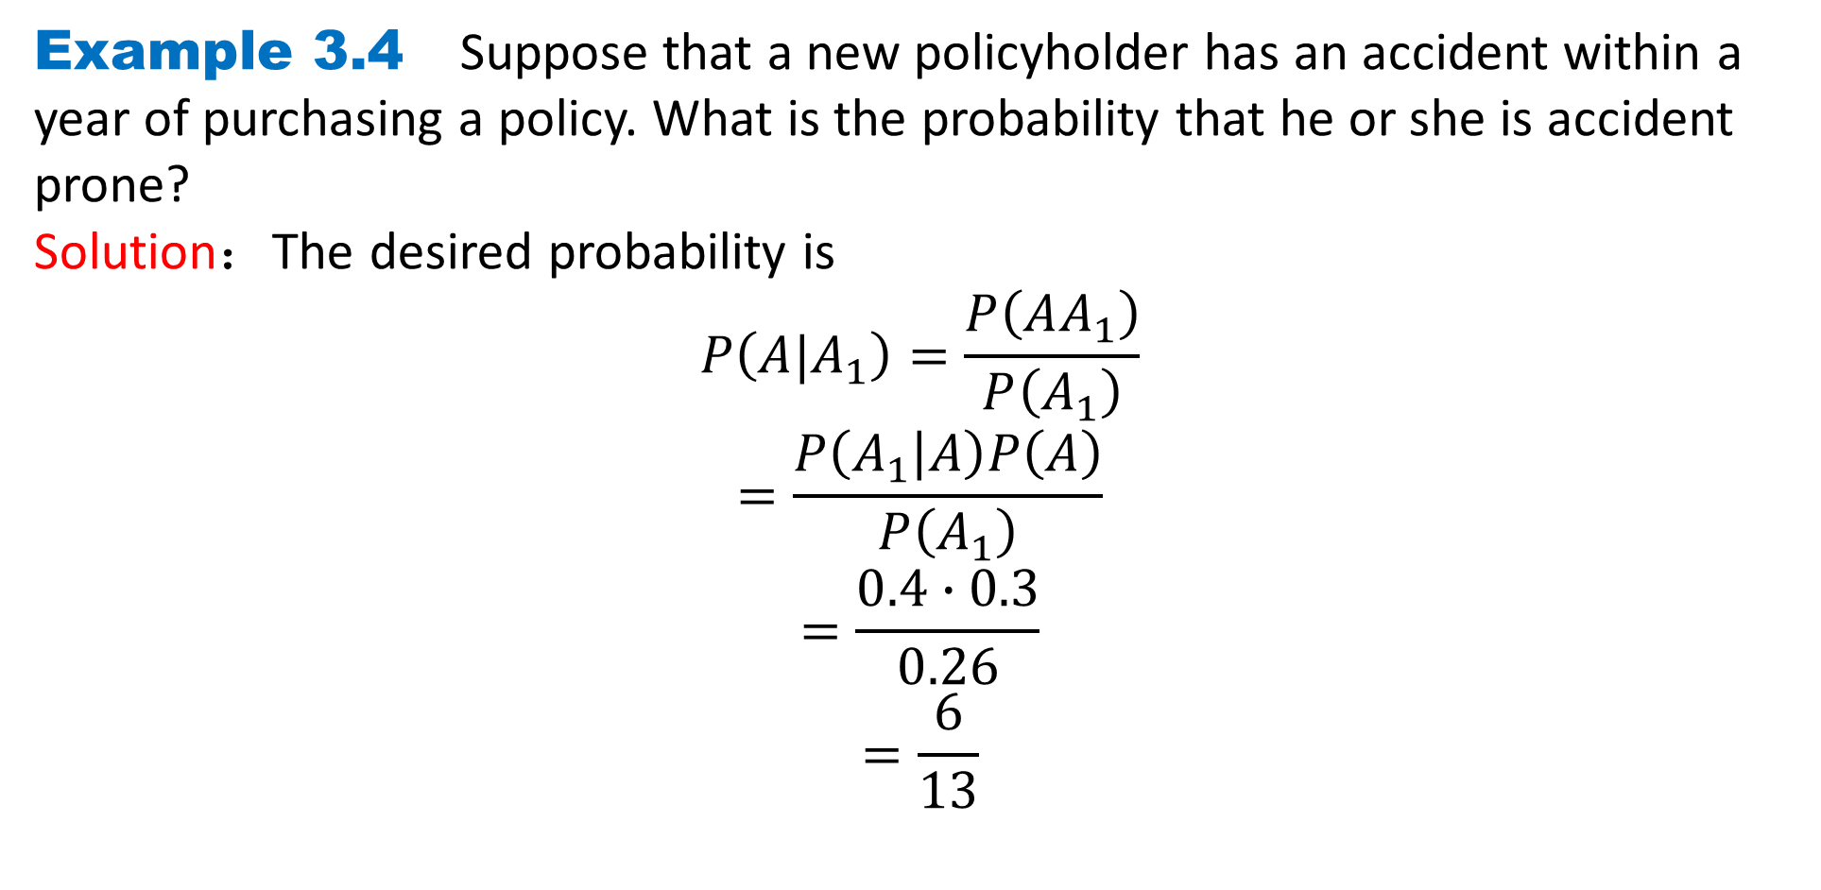
DLI
Example 3.4 Suppose that a new policyholder has an accident within a year of purchasing a policy. What is the probability that he or she is accident prone?
Solution：The desired probability is
$$P\left(A|A_{1}\right)=\frac{P\left(AA_{1}\right)}{P\left(A_{1}\right)}$$
$$=\frac{P\left(A_{1} | A\right)P\left(A\right)}{P\left(A_{1}\right)}$$
$$=\frac{0.4∙0.3}{0.26}$$
$$=\frac{6}{13}$$

Slide 12
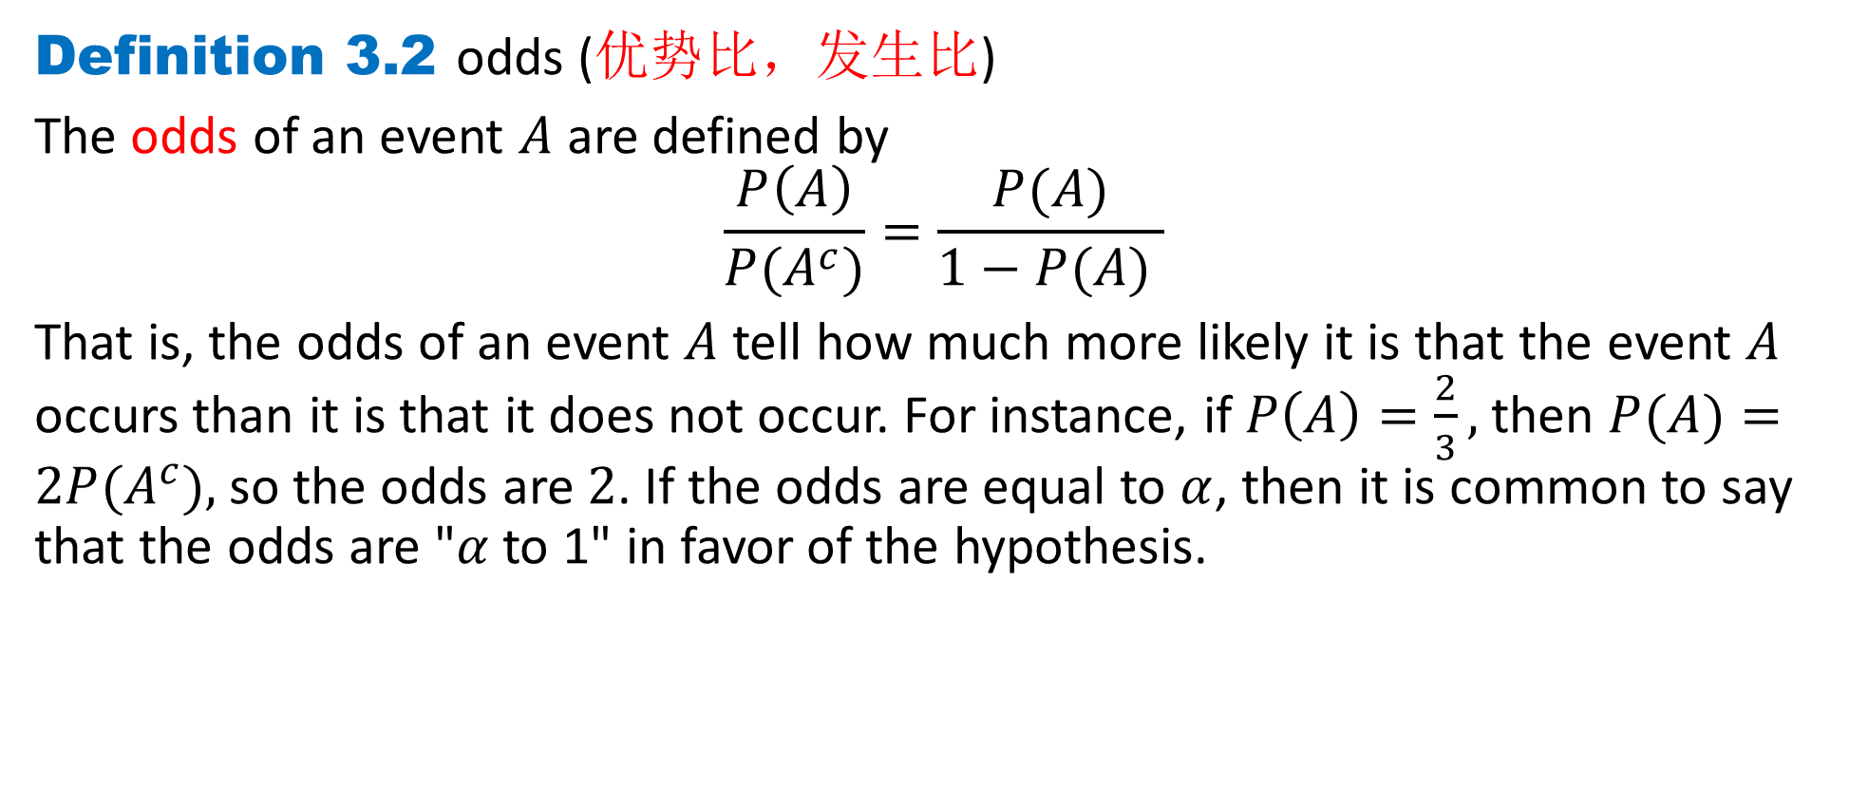
DLI
Definition 3.2 odds (优势比，发生比)
The odds of an event $A$ are defined by
$$\frac{P\left(A\right)}{P(A^{c})}=\frac{P(A)}{1−P(A) }$$
That is, the odds of an event $A$ tell how much more likely it is that the event $A$ occurs than it is that it does not occur. For instance, if $P\left(A\right)=\frac{2}{3},$ then $P(A)=2P(A^{c}),$so the odds are $2$. If the odds are equal to $α$, then it is common to say that the odds are "$α$to 1" in favor of the hypothesis.

Slide 13
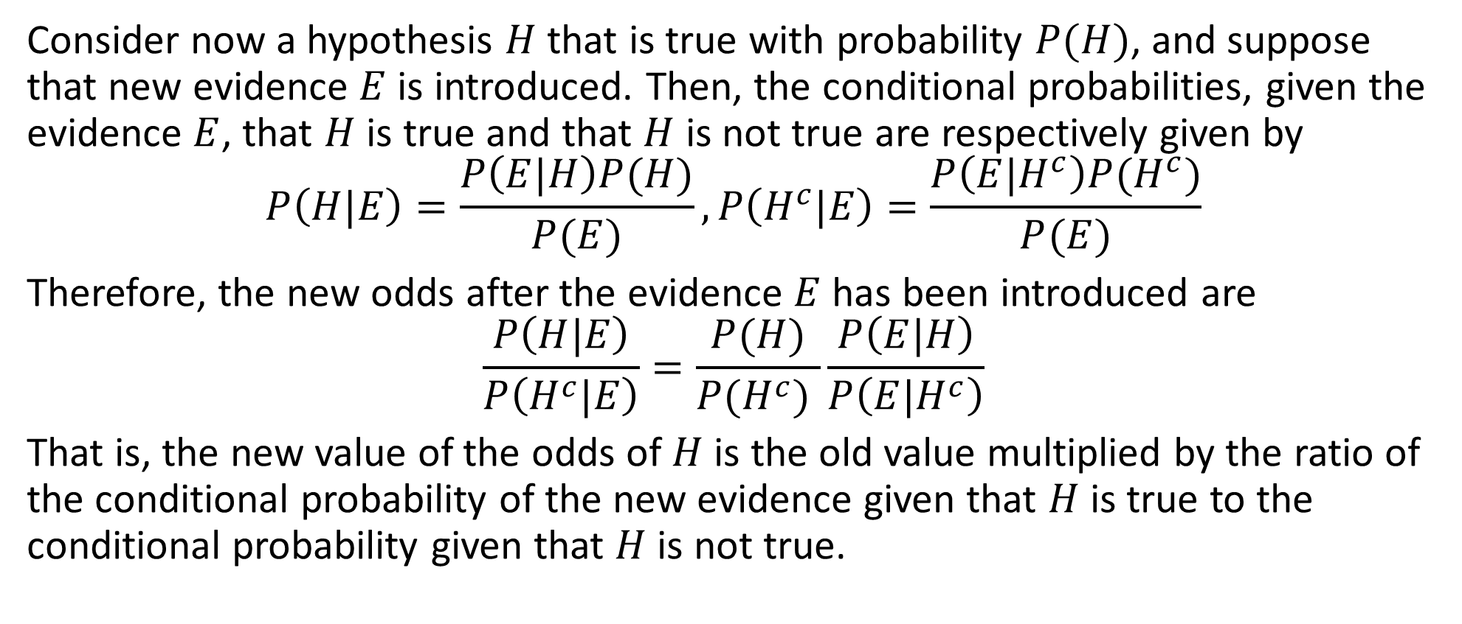
DLI
Consider now a hypothesis $H$ that is true with probability $P(H)$, and suppose that new evidence $E$is introduced. Then, the conditional probabilities, given the evidence $E$, that $H$ is true and that $H$ is not true are respectively given by
$$P\left(H|E\right)=\frac{P\left(E|H\right)P(H)}{P(E)},P\left(H^{c}|E\right)=\frac{P\left(E|H^{c}\right)P(H^{c})}{P(E)}$$
Therefore, the new odds after the evidence $E$ has been introduced are
$$\frac{P\left(H|E\right)}{P\left(H^{c}|E\right)}=\frac{P(H)}{P(H^{c}) }\frac{P\left(E|H\right)}{P\left(E|H^{c}\right)}$$
That is, the new value of the odds of $H$ is the old value multiplied by the ratio of the conditional probability of the new evidence given that $H$ is true to the conditional probability given that $H$ is not true.

Slide 14
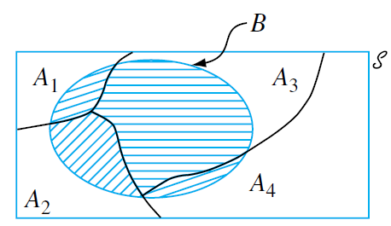

DLI
Definition 3.3 Complete event group(完备事件组，partitioning 划分)
The events $A_{1}, . . . , A_{k}$are mutually exclusive(互斥) if no two have any common outcomes. The events are exhaustive(穷尽) if one $A_{i}$ must occur, so that $A_{1}∪. . . ∪A_{k}=S.$ We call ${\{A}_{1}, . . . , A_{k}\}$ is a complete event group if $A_{1}, . . . , A_{k}$are mutually exclusive and exhaustive events.

Slide 15
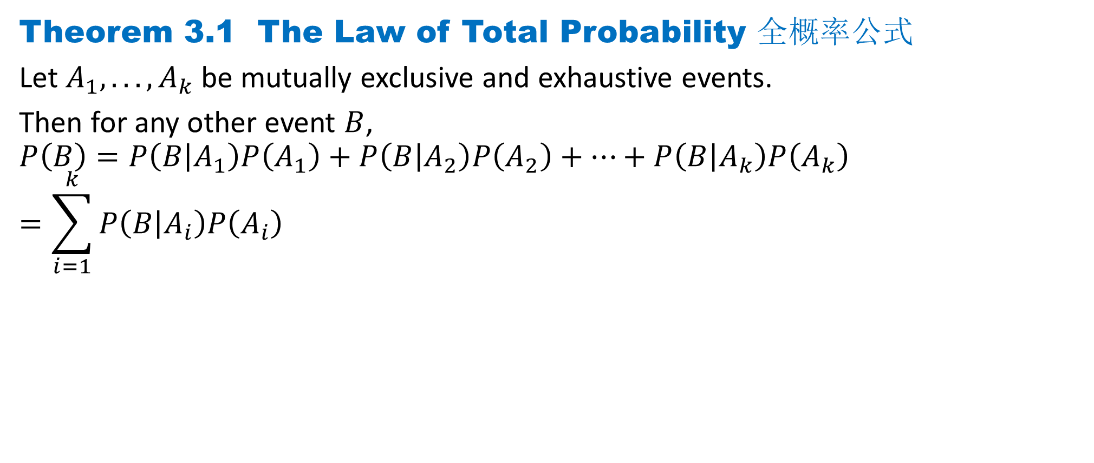
DLI
Theorem 3.1 The Law of Total Probability 全概率公式
Let $A_{1}, . . . , A_{k}$be mutually exclusive and exhaustive events.
Then for any other event $B$,
$$P\left(B\right)=P\left(B | A_{1}\right)P\left(A_{1}\right)+P\left(B | A_{2}\right)P\left(A_{2}\right)+⋯+P\left(B | A_{k}\right)P\left(A_{k}\right)$$
$$=\sum_{i=1}^{k}{P\left(B | A_{i}\right)P\left(A_{i}\right)}$$

Slide 16
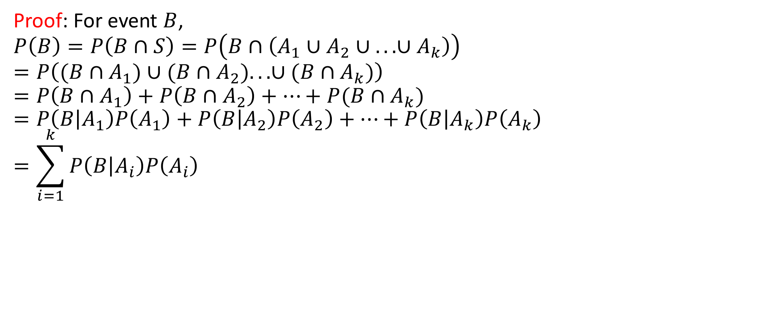
DLI
Proof: For event $B$,
$$P\left(B\right)=P\left(B∩S\right)=P\left(B∩\left(A_{1}∪A_{2}∪ .. . ∪A_{k}\right)\right)$$
$$=P\left((B∩A_{1})∪(B∩A_{2}). . . ∪{(B∩A}_{k})\right)$$
$$=P\left(B∩A_{1}\right)+P\left(B∩A_{2}\right)+⋯+P{(B∩A}_{k})$$
$$=P\left(B | A_{1}\right)P\left(A_{1}\right)+P\left(B | A_{2}\right)P\left(A_{2}\right)+⋯+P\left(B | A_{k}\right)P\left(A_{k}\right)$$
$$=\sum_{i=1}^{k}{P\left(B | A_{i}\right)P\left(A_{i}\right)}$$

Slide 17
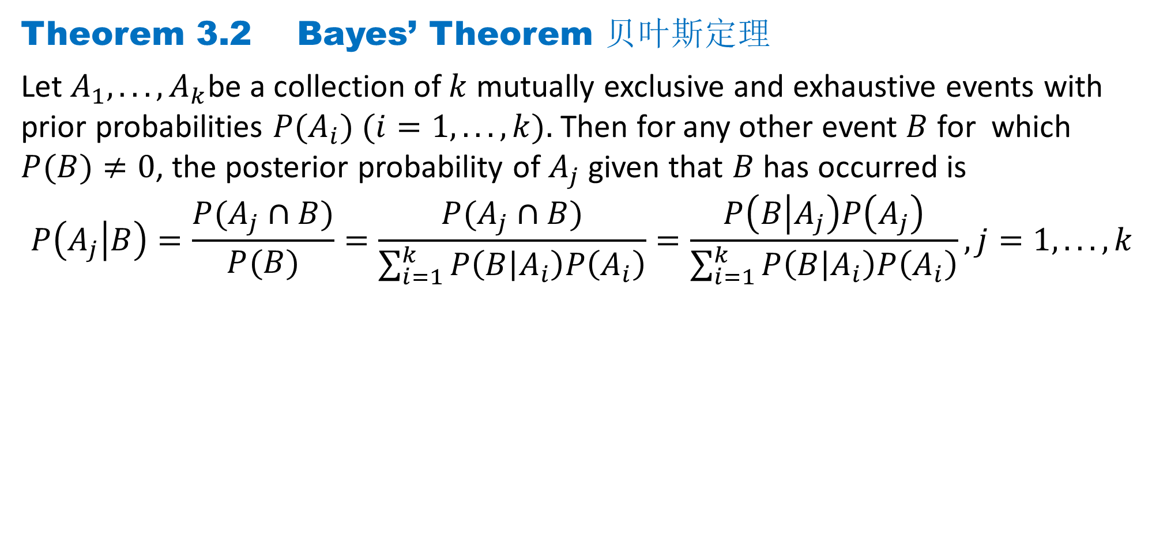
DLI
Theorem 3.2 Bayes’ Theorem 贝叶斯定理
Let $A_{1}, . . . , A_{k}$be a collection of $k$ mutually exclusive and exhaustive events with prior probabilities $P(A_{i}) (i=1, . . . , k).$Then for any other event $B$ for which $P(B)≠0$, the posterior probability of $A_{j}$ given that $B$ has occurred is
$$P\left(A_{j} | B\right)=\frac{P(A_{j}∩B)}{P(B)}=\frac{P(A_{j}∩B)}{\sum_{i=1}^{k}{P\left(B | A_{i}\right)P\left(A_{i}\right)}}=\frac{P\left(B | A_{j}\right)P\left(A_{j}\right)}{\sum_{i=1}^{k}{P\left(B | A_{i}\right)P\left(A_{i}\right)}},j=1, . . . , k$$

Slide 18
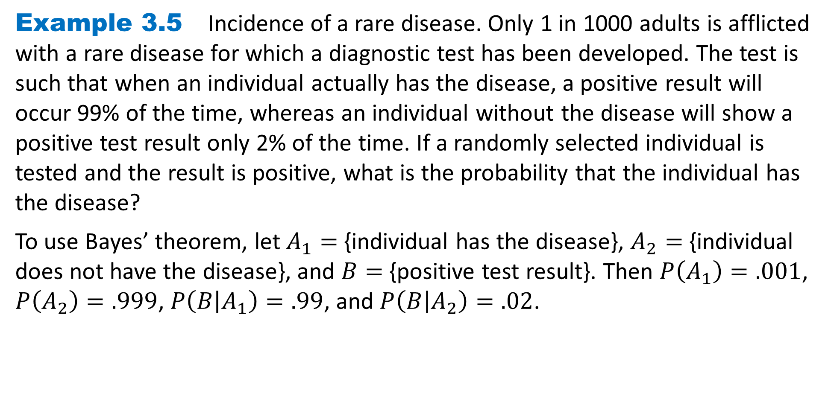
DLI
Example 3.5 Incidence of a rare disease. Only 1 in 1000 adults is afflicted with a rare disease for which a diagnostic test has been developed. The test is such that when an individual actually has the disease, a positive result will occur 99% of the time, whereas an individual without the disease will show a positive test result only 2% of the time. If a randomly selected individual is tested and the result is positive, what is the probability that the individual has the disease?
To use Bayes’ theorem, let $A_{1}=${individual has the disease}, $A_{2}=$ {individual does not have the disease}, and $B=${positive test result}. Then $P\left(A_{1}\right)=.001$, $P\left(A_{2}\right)=.999$, $P\left(B | A_{1}\right)=.99$, and $P\left(B | A_{2}\right)=.02$.

Slide 19
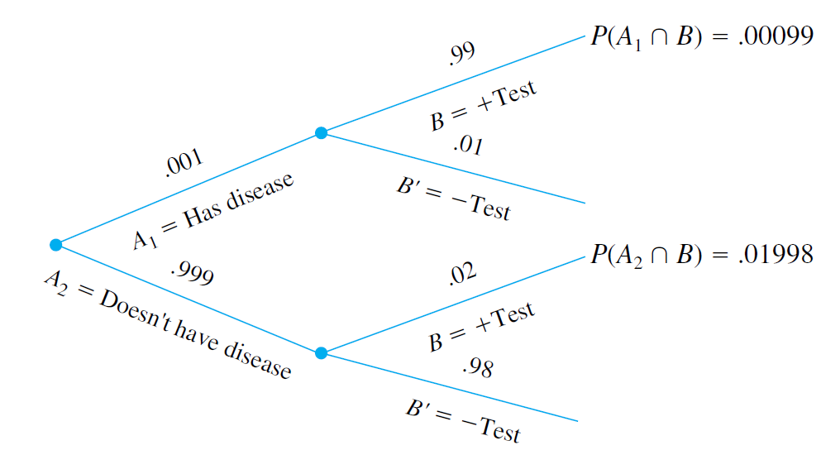
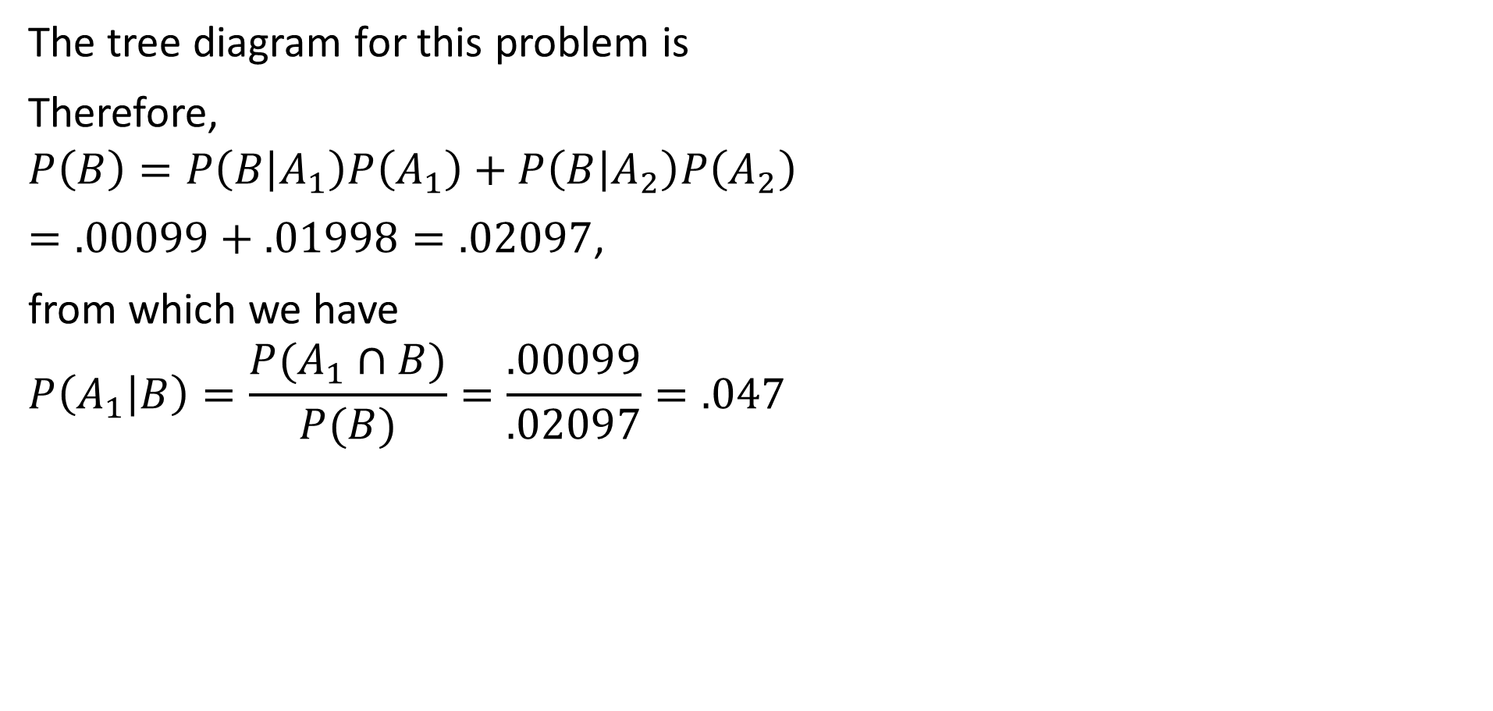
DLI
The tree diagram for this problem is
Therefore,
$$P\left(B\right)=P\left(B | A_{1}\right)P\left(A_{1}\right)+P\left(B | A_{2}\right)P\left(A_{2}\right)$$
$=.00099+.01998=.02097$,
from which we have
$$P\left(A_{1} | B\right)=\frac{P(A_{1}∩B)}{P(B)}=\frac{.00099}{.02097}=.047$$

Slide 20
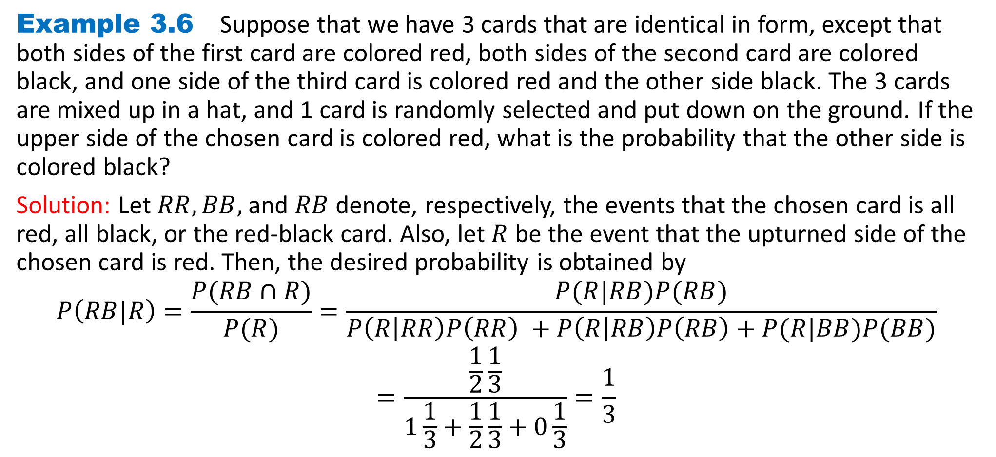
DLI
Example 3.6 Suppose that we have 3 cards that are identical in form, except that both sides of the first card are colored red, both sides of the second card are colored black, and one side of the third card is colored red and the other side black. The 3 cards are mixed up in a hat, and 1 card is randomly selected and put down on the ground. If the upper side of the chosen card is colored red, what is the probability that the other side is colored black?
Solution: Let $RR, BB,$and $RB$ denote, respectively, the events that the chosen card is all red, all black, or the red-black card. Also, let $R$ be the event that the upturned side of the chosen card is red. Then, the desired probability is obtained by
$$P\left(RB|R\right)=\frac{P(RB∩R)}{P(R)}=\frac{P(R|RB)P(RB)}{P\left(R | RR\right)P\left(RR\right) +P\left(R | RB\right)P\left(RB\right)+P(R|BB)P(BB)}$$
$$=\frac{\frac{1}{2}\frac{1}{3}}{1\frac{1}{3}+\frac{1}{2}\frac{1}{3}+0\frac{1}{3}}=\frac{1}{3}$$

Slide 21
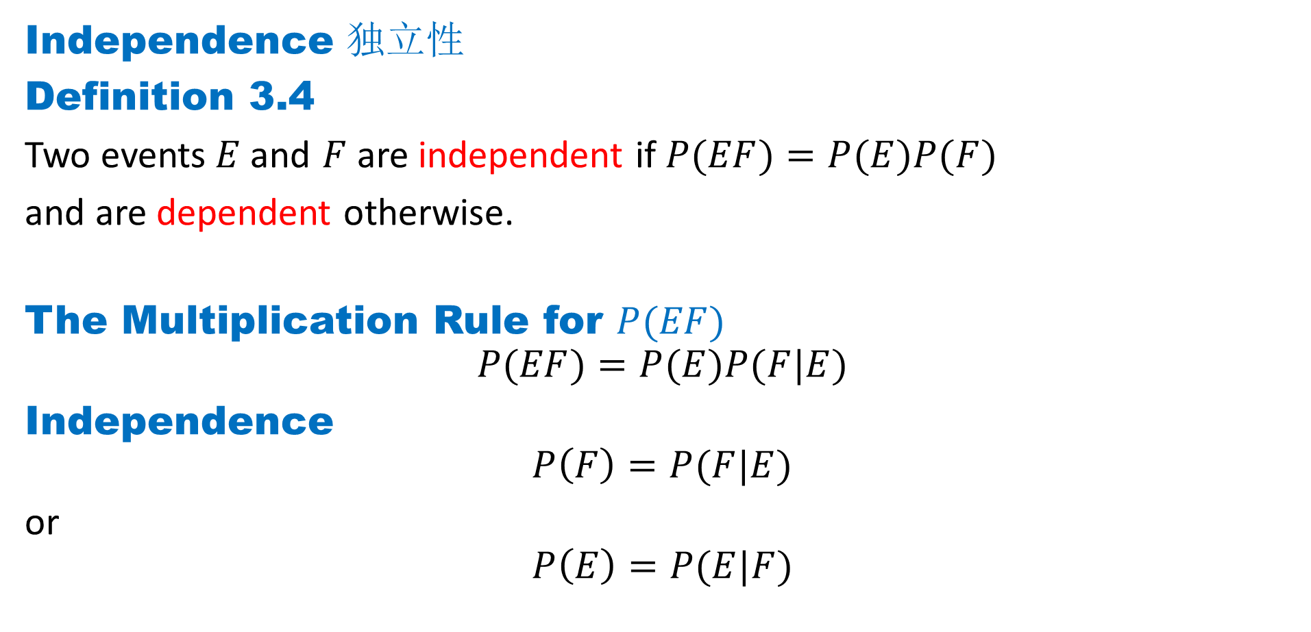
DLI
Independence 独立性
Definition 3.4
Two events$E$and $F$ are independent if $P(EF)=P(E)P(F)$
and are dependent otherwise.
The Multiplication Rule for $P(EF)$
$$P(EF)=P(E)P(F|E)$$
Independence
$$P\left(F\right)=P(F|E)$$
or
$$P\left(E\right)=P(E|F)$$

Slide 22

DLI
Example 3.7 A card is selected at random from an ordinary deck of 52 playing cards. If $E$ is the event that the selected card is an ace and $F$ is the event that it is a spade, then $E$ and $F$ are independent.
This follows because $P(EF)=\frac{1}{52}$, whereas $P(E)=\frac{4}{52}$ and $P(F)=\frac{13}{52}$·

Slide 23
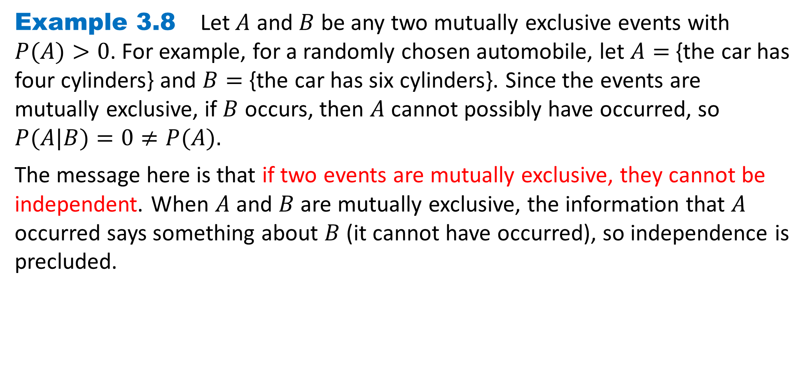
DLI
Example 3.8 Let $A$ and $B$ be any two mutually exclusive events with $P(A)>0$. For example, for a randomly chosen automobile, let $A=$ {the car has four cylinders} and $B=$ {the car has six cylinders}. Since the events are mutually exclusive, if $B$ occurs, then $A$ cannot possibly have occurred, so $P(A|B)=0≠P(A).$
The message here is that if two events are mutually exclusive, they cannot be independent. When $A$ and $B$ are mutually exclusive, the information that $A$ occurred says something about $B$ (it cannot have occurred), so independence is precluded.

Slide 24
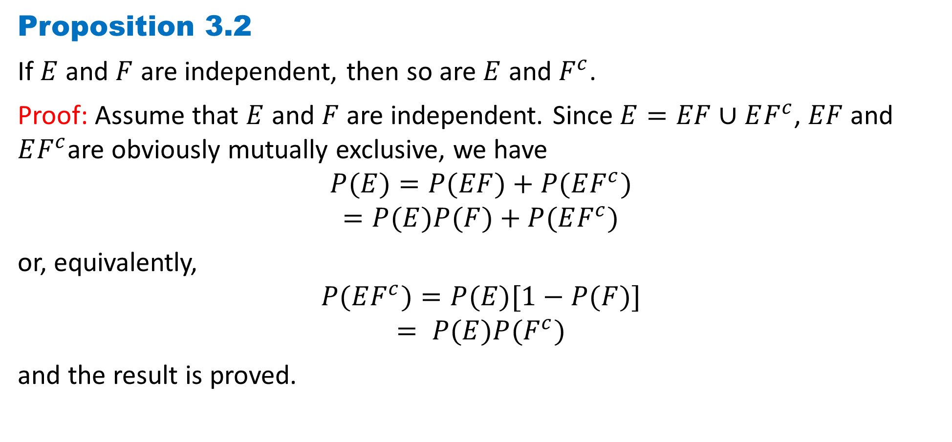
DLI
Proposition 3.2
If $E$ and $F$ are independent, then so are $E$ and $F^{c}$.
Proof: Assume that $E$ and $F$ are independent. Since $E=EF∪EF^{c}$, $EF$and $EF^{c}$are obviously mutually exclusive, we have
$$P(E)=P(EF)+P(EF^{c})$$
$$=P(E)P(F)+P(EF^{c})$$
or, equivalently,
$$P(EF^{c})=P(E)[1−P(F)]$$
$$= P(E)P(F^{c})$$
and the result is proved.

Slide 25
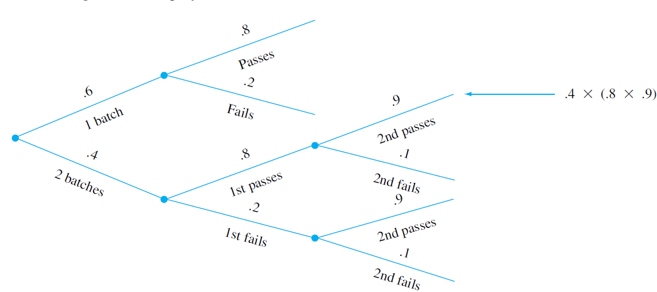
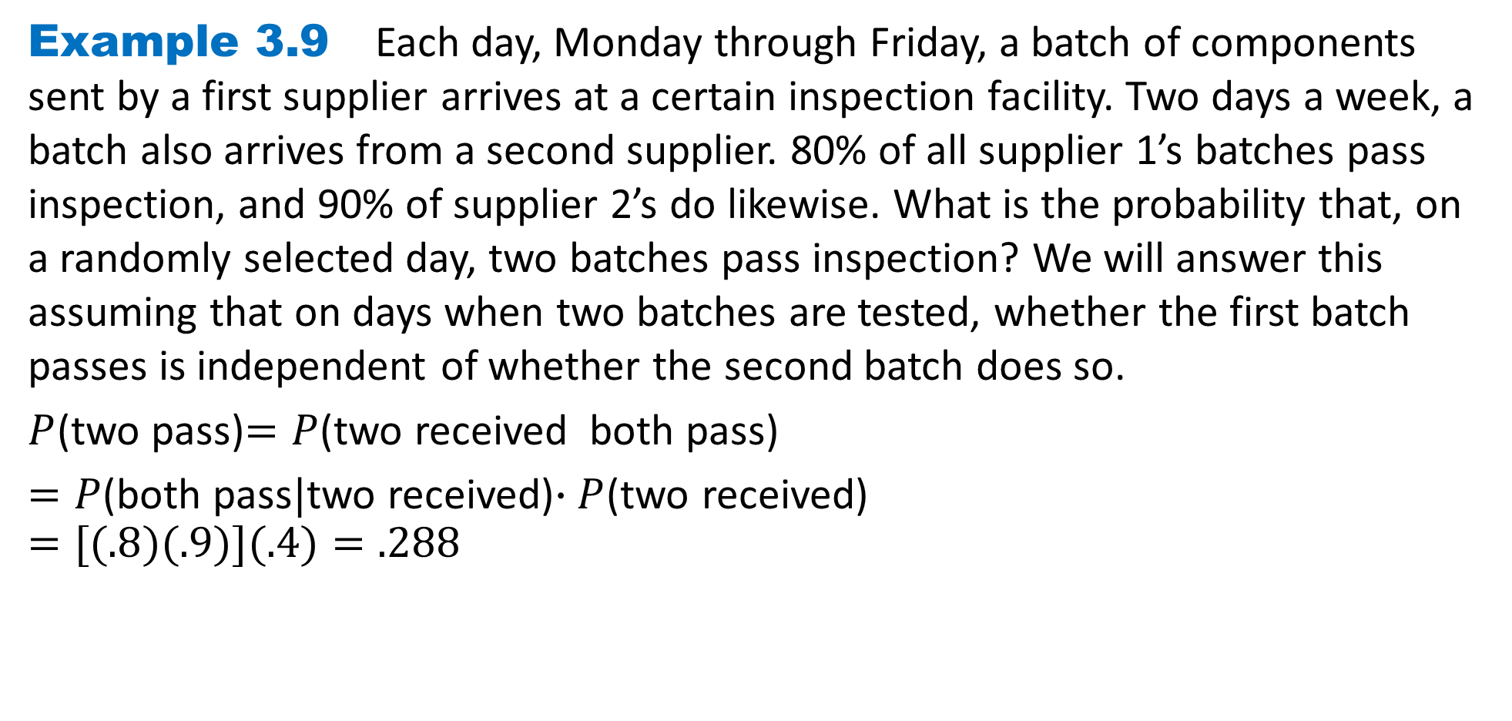
DLI
Example 3.9 Each day, Monday through Friday, a batch of components sent by a first supplier arrives at a certain inspection facility. Two days a week, a batch also arrives from a second supplier. 80% of all supplier 1’s batches pass inspection, and 90% of supplier 2’s do likewise. What is the probability that, on a randomly selected day, two batches pass inspection? We will answer this assuming that on days when two batches are tested, whether the first batch passes is independent of whether the second batch does so.
$P$(two pass)$=P$(two received both pass)
$=P$(both pass$|$two received)$∙P$(two received)
$$=[(.8)(.9)](.4)=.288$$

Slide 26
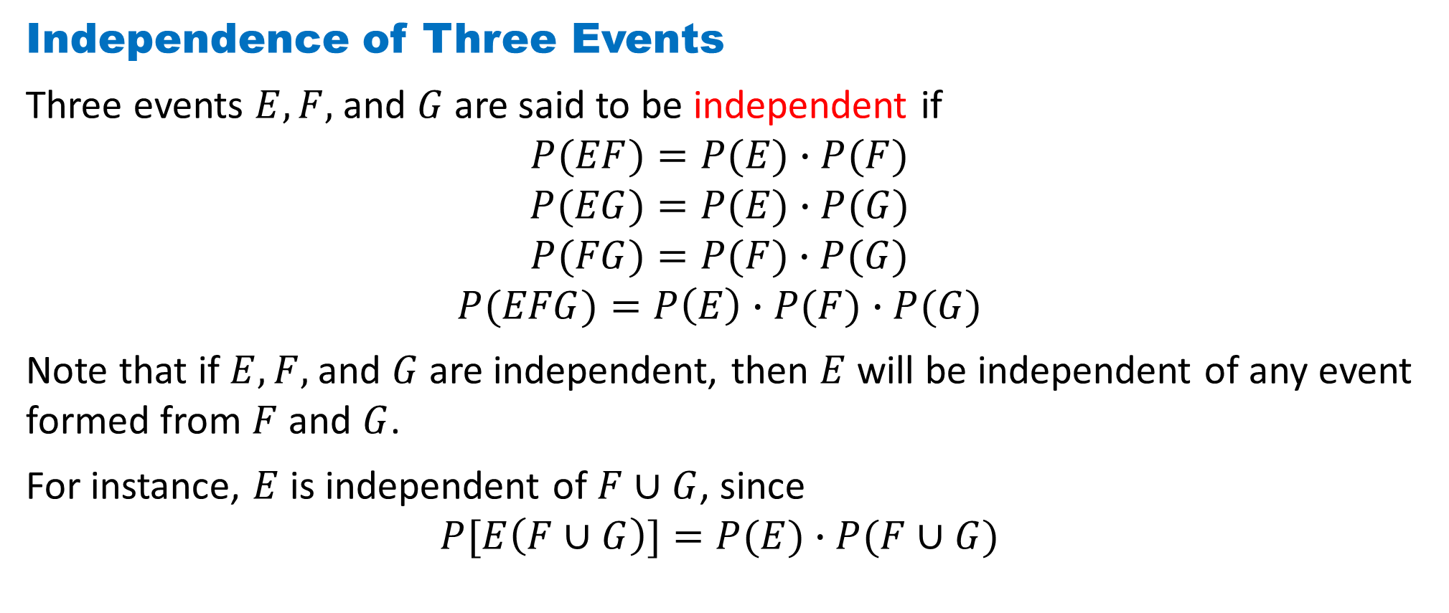
DLI
Independence of Three Events
Three events $E, F,$and $G$are said to be independent if
$$P(EF)=P(E)∙P(F)$$
$$P(EG)=P(E)∙P(G)$$
$$P(FG)=P(F)∙P(G)$$
$$P(EFG)=P\left(E\right)∙P(F)∙P(G)$$
Note that if $E, F,$and $G$are independent, then $E$ will be independent of any event formed from $F$ and $G$.
For instance, $E$ is independent of $F∪G$, since
$$P[E\left(F∪G\right)]=P(E)∙P(F∪G)$$

Slide 27
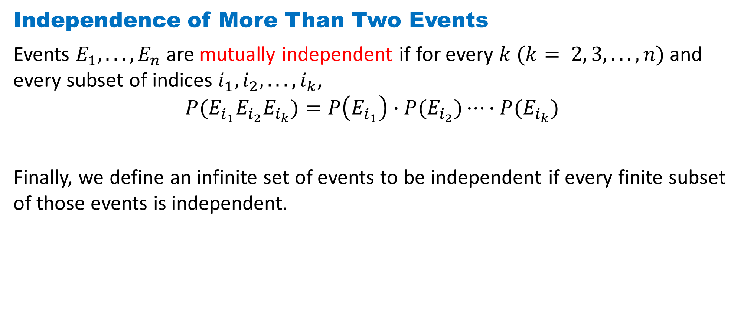
DLI
Independence of More Than Two Events
Events $E_{1}, . . . , E_{n}$are mutually independent if for every $k (k= 2, 3, . . . , n)$and every subset of indices $i_{1}, i_{2}, . . . , i_{k}$,
$$P(E_{i_{1}}E_{i_{2}}E_{i_{k}})=P\left(E_{i_{1}}\right)∙P(E_{i_{2}})⋯∙P(E_{i_{k}})$$
Finally, we define an infinite set of events to be independent if every finite subset of those events is independent.

Slide 28
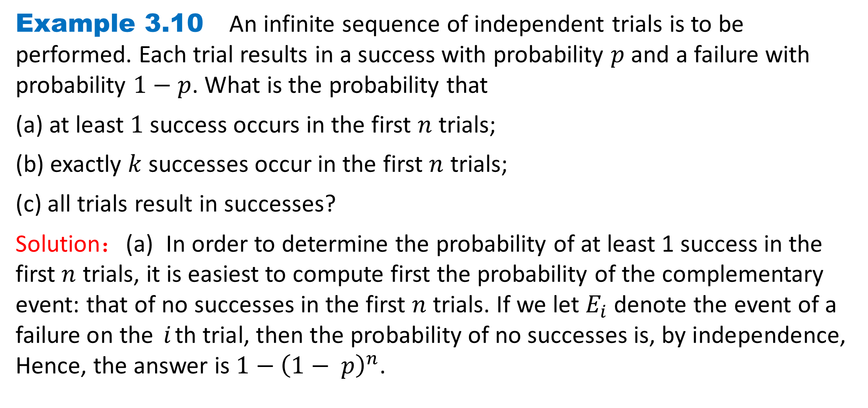
DLI
Example 3.10 An infinite sequence of independent trials is to be performed. Each trial results in a success with probability $p$ and a failure with probability $1−p$. What is the probability that
(a) at least $1$ success occurs in the first $n$ trials;
(b) exactly $k$successes occur in the first $n$ trials;
(c) all trials result in successes?
Solution：(a) In order to determine the probability of at least 1 success in the first $n$ trials, it is easiest to compute first the probability of the complementary event: that of no successes in the first $n$ trials. If we let $E_{i}$ denote the event of a failure on the $i$th trial, then the probability of no successes is, by independence, Hence, the answer is $1−{\left(1− p\right)}^{n}$.

Slide 29
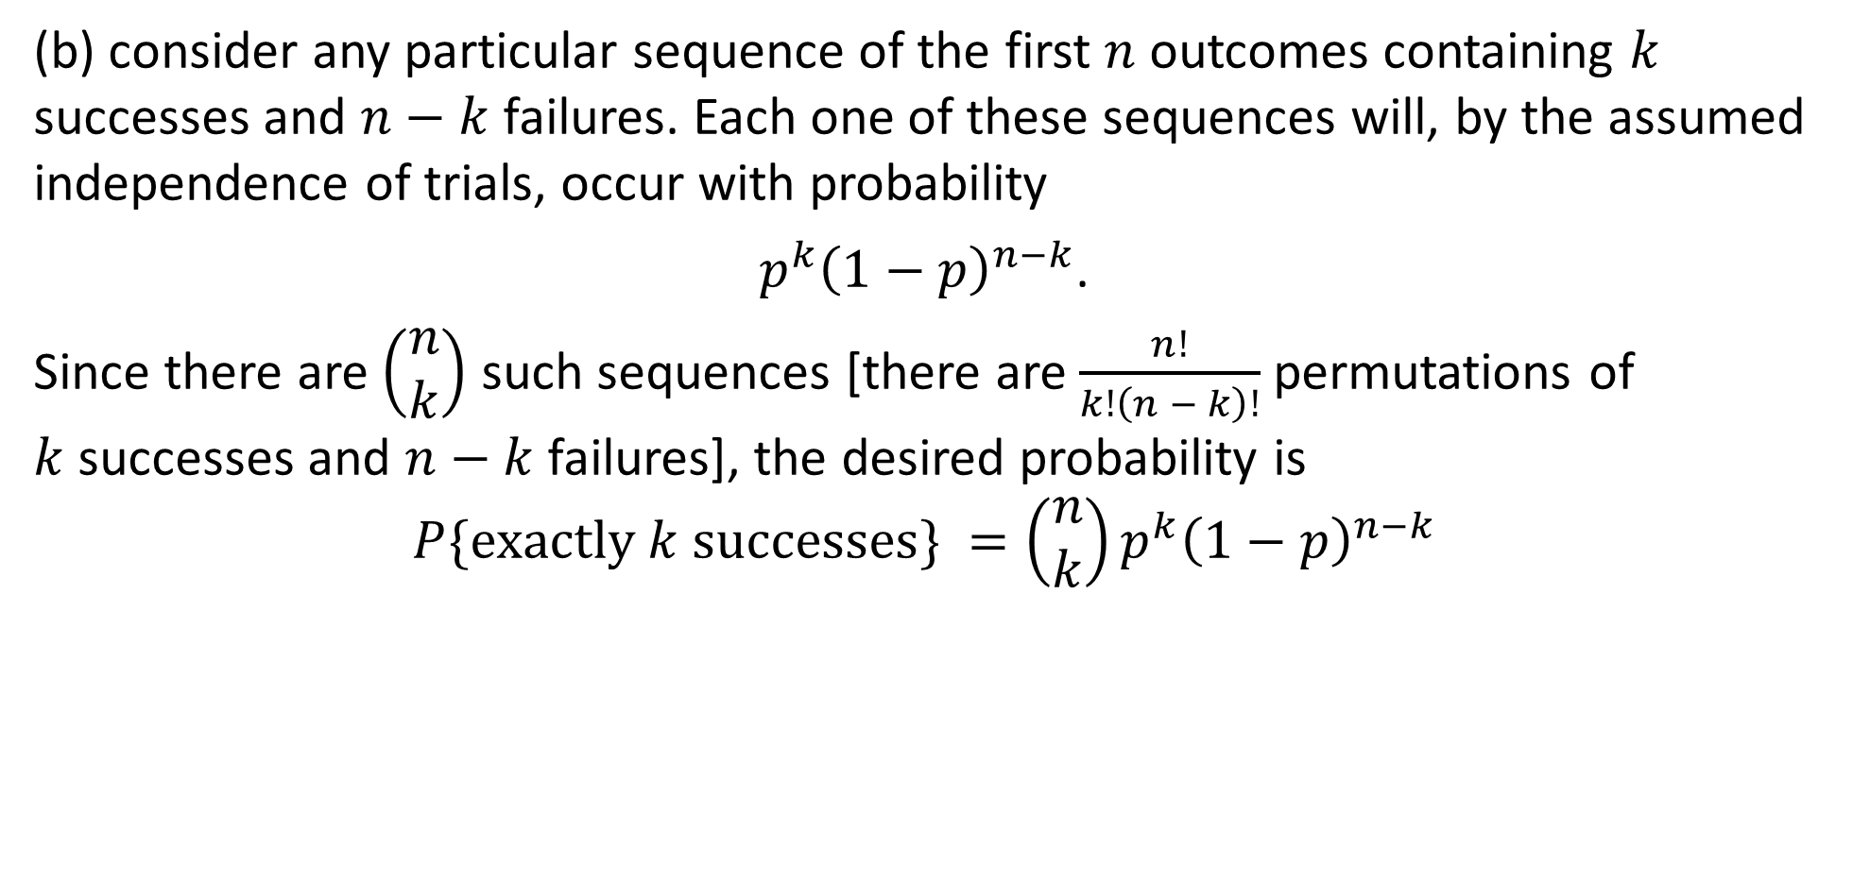
DLI
(b) consider any particular sequence of the first $n$ outcomes containing $k$ successes and $n−k$failures. Each one of these sequences will, by the assumed independence of trials, occur with probability
$p^{k}{\left(1−p\right)}^{n−k}$.
Since there are $\left(\begin{matrix}n \\ k\end{matrix}\right)$ such sequences [there are $\frac{n!}{k!\left(n − k\right)!}$ permutations of $k$successes and $n−k$failures], the desired probability is
$$P\{exactly k successes\} =\left(\begin{matrix}n \\ k\end{matrix}\right)p^{k}{\left(1−p\right)}^{n−k}$$

Slide 30
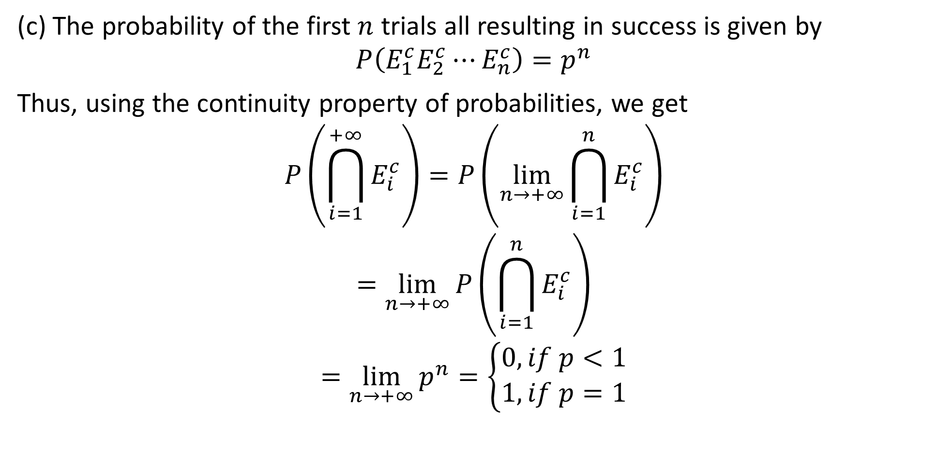
DLI
(c) The probability of the first $n$ trials all resulting in success is given by
$${P\left(E_{1}^{c}E_{2}^{c}⋯E_{n}^{c}\right)=p}^{n}$$
Thus, using the continuity property of probabilities, we get
$$P\left(\bigcap_{i=1}^{+∞}{E_{i}^{c}}\right)=P\left(\lim_{n→+∞}{\bigcap_{i=1}^{n}{E_{i}^{c}}}\right)$$
$$=\lim_{n→+∞}{P\left(\bigcap_{i=1}^{n}{E_{i}^{c}}\right)}$$
$$=\lim_{n→+∞}{p^{n}}=\left\{\begin{matrix}0, if p<1 \\ 1, if p=1\end{matrix}\right.$$

Slide 31
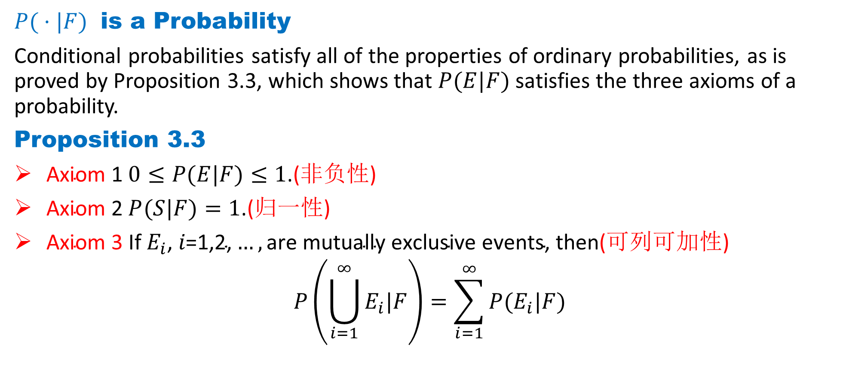
DLI
$P( ·|F)$ is a Probability
Conditional probabilities satisfy all of the properties of ordinary probabilities, as is proved by Proposition 3.3, which shows that $P(E|F)$ satisfies the three axioms of a probability.
Proposition 3.3
$\text{Axiom}\text{ 1 }0≤P(E|F)≤1\text{.}\text{(}\text{非负性}\text{)}$
$\text{Axiom}\text{ 2 }P(S|F)=1\text{.}\text{(}\text{归一性}\text{)}$
$\text{Axiom}\text{ 3 }\text{If} E_{i}\text{,} i\text{=1,2,}…,\text{are} \text{mutually} \text{exclusive} \text{events}\text{, }\text{then}\text{(}\text{可列可加性}\text{)}$
$$P\left(\bigcup_{i=1}^{∞}{E_{i}|F}\right)=\sum_{i=1}^{∞}{P(E_{i}|F)}$$

Slide 32
DLI
Homework
Page 102 Problems
1, 12, 15, 18, 26, 40, 70
Page 111 Theoretical Exercises
2, 5, 25
Page 114 Self-Test Problems and Exercises
5, 8, 10, 23, 31

